Slide 1
CS 5413
Data Structures and
Algorithm Analysis II

Slide 2
Chapter 15:
Dynamic Programming
Not a specific algorithm, but a technique (like divide-and-conquer).
Developed when “programming” meant “tabular method” (like linear programming).
  Does not refer to computer programming.
Used for optimization problems:
  Find a solution with the optimal value.
  Typically: Minimization or maximization.

Slide 3
DP vs D&C
Divide-and-Conquer:
  Partition problem into independent subproblems
  Solve subproblems recursively
  Combine solutions to solve original problem
Dynamic Programming:
  Subproblems are not independent, but share sub-subproblems
  In such cases, D&C does more work than needed
  DP solves each subproblem just once

Slide 4
Methodology
Four-step method
  Characterize the structure of an optimal solution.
  Recursively define the value of an optimal solution.
  Compute the value of an optimal solution in a bottom-up fashion.
  Optional: Construct an optimal solution from computed information.

Slide 5
Example:
Assembly-line scheduling
Automobile factory with two assembly lines:
  Each line has n stations:
  S_{1,1}, . . . , S_{1,n} and S_{2,1}, . . . , S₂,n.
  Corresponding stations S_{1, j} and S_{2, j} perform the same function but can take different amounts of time a_{1, j} and a_{2, j}
  Entry times e₁ and e₂
  Exit times x₁ and x₂
  After going through a station, can either
    stay on same line; no cost, or
    transfer to other line; cost after S_{i, j} is t_{i, j}
    ( j = 1, . . . , n-1. No t_{i,n} , because the assembly line is done after S_{i,n})

Slide 6
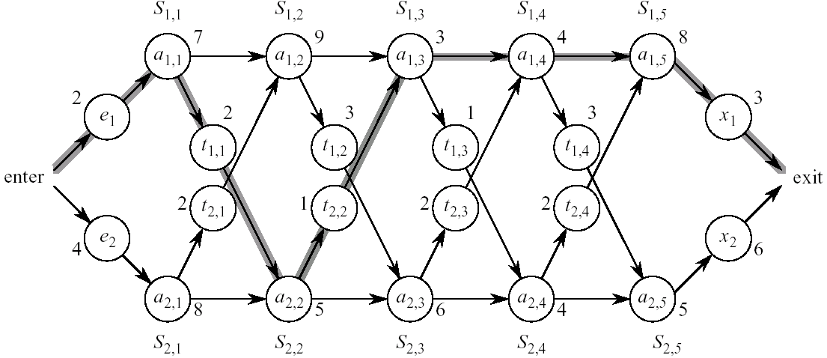
Example
Assembly-line scheduling

Slide 7
Assembly-line scheduling
Problem:
  Given all these costs (time = cost), what stations should be chosen from line 1 and from line 2 for fastest way through factory?
Try all possibilities?
  Each candidate is fully specified by which stations from line 1 are included.
  Looking for a subset of line 1 stations.
  Line 1 has n stations.
  2^{n} subsets.
  Infeasible when n is large.

Slide 8
ALS: The DP Solution
Step 1: Find structure of optimal solution
  (Think about fastest way from entry through S_{1, j} .)
  If j = 1 (first station), easy: just determine how long it takes to get through S_{1,1}.
  If j ≥ 2, have two choices of how to get to S_{1, j} :
    Through S_{1, j−1}, then directly to S_{1, j} .
    Through S_{2, j−1}, then transfer over to S_{1, j} .
  Suppose fastest way is through S_{1, j − 1}.

Slide 9
ALS: The DP Solution (cont’d.)
Key observation:
  We must have taken a fastest way from entry through S_{1, j −1} in this solution. If there were a faster way through S_{1, j −1}, we would use it instead to come up with a faster way through S_{1, j} .
  Now suppose a fastest way is through S_{2, j −1}. Again, we must have taken a fastest way through S_{2, j −1}. Otherwise use some faster way through S_{2, j −1} to give a faster way through S_{1, j} .
Generally:
  An optimal solution to a problem (fastest way through S_{1, j} ) contains within it an optimal solution to subproblems (fastest way through S_{1, j −1} or S_{2, j −1}).
  This is optimal substructure.

Slide 10
ALS: The DP Solution (cont’d.)
Use optimal substructure to construct optimal solution to problem from optimal solutions to subproblems:
  fastest way through S_{1, j} is either fastest way through S_{1, j−1} then directly through S_{1, j}, or
  fastest way through S_{2, j−1}, transfer from line 2 to line 1, then through S_{1, j} .
Symmetrically for S_{2, j}
Therefore:
  Solve problems of finding a fastest way through S_{1, j} and S_{2, j} , solve subproblems of finding a fastest way through S_{1, j−1} and S_{2, j−1}.

Slide 11
ALS: The DP Solution (cont’d.)
Step 2: Define a recursive solution
  Let f_{i} [ j ] = fastest time to get through S_{i, j}
  i = 1, 2 and j = 1, … , n
  Goal: fastest time to get all the way through = f *
    f * = min( f₁[n] + x₁, f₂[n] + x₂)
  f₁[1] = e₁ + a_{1,1}
  f₂[1] = e₂ + a_{2,1}
  For j = 2, … , n:
  f₁[j ] = min(f₁[ j −1] + a_{1, j} , f₂[ j −1] + t_{2, j − 1} + a_{1, j} )
  f₂[j ] = min(f₂[ j −1] + a_{2, j} , f₁[ j −1] + t_{1, j − 1} + a_{2, j} )

Slide 12
ALS: The DP Solution (cont’d.)
f_{i} [ j ] gives the value of an optimal solution.
What if we want to construct an optimal solution?
Define l_{i} [ j ] = line # (1 or 2) whose station
j − 1 is used in fastest way through S_{i, j} .
  In other words S_{li [ j ], j−1} precedes S_{i, j} .
  Defined for i = 1, 2 and j = 2, . . . , n.
  l ∗ = line # whose station n is used.

Slide 13
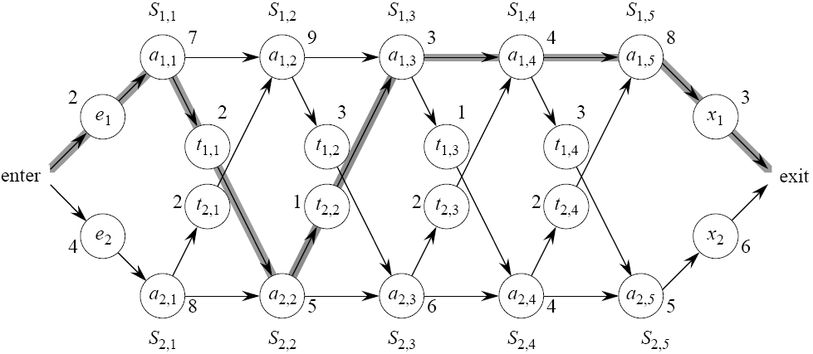
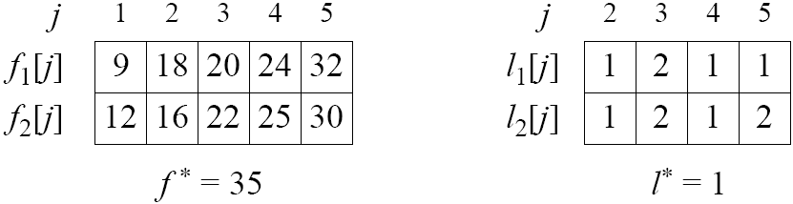
ALS: The DP Solution (cont’d.)

Slide 14
ALS: The DP Solution (cont’d.)
Step 3: Compute optimal value
  Could just write a recursive algorithm based on above recurrences (top-down approach).
    Problem: Such algorithm would be exponential due to the large number of overlapping subproblems
    Let r_{i} ( j ) = # of references made to f_{i} [ j ]
    r_{i} ( j ) = 2^{n−j}
      Prove by induction based on recursion defined earlier

Slide 15
ALS: The DP Solution (cont’d.)
Observation: f_{i} [ j ] depends only on
f₁[ j − 1] and f₂[ j − 1] (for j ≥ 2).
  So compute in order of increasing j (bottom-up approach).

Slide 16
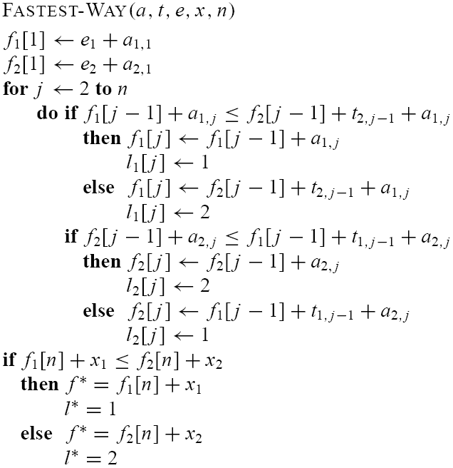
ALS: The DP Solution (cont’d.)

Slide 17
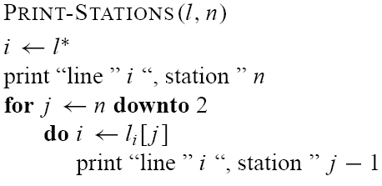
ALS: The DP Solution (cont’d.)
Step 4: Construct optimal solution

Slide 18
Elements of
Dynamic Programming
Optimal substructure
Overlapping subproblems
Memoization

Slide 19
Optimal Substructure
Show that a solution to a problem consists of making a choice, which leaves one or more subproblems to solve.
  Suppose that you are given the last choice that leads to an optimal solution.
  Given this choice, determine which subproblems arise and how to characterize the resulting space of subproblems.

Slide 20
Optimal Substructure
  Show that the solutions to the subproblems used within the optimal solution must themselves be optimal.
  Use cut-and-paste:
    Assume that one of the subproblem solutions is not optimal.
    Cut it out.
    Paste in an optimal solution.
    Get a better solution to the original problem. Contradicts optimality of problem solution.

Slide 21
Optimal Substructure
Optimal substructure varies across problem domains:
  How many subproblems are used in an optimal solution.
  How many choices in determining which subproblem(s) to use.
Assembly-line scheduling:
  1 subproblem used in solution
  2 choices (for S_{i, j} : either S_{1, j−1} or S_{2, j−1})

Slide 22
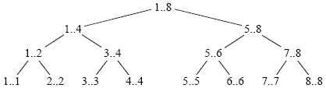
Overlapping Subproblems
These occur when a recursive algorithm revisits the same problem over and over.
  Good divide-and-conquer algorithms usually generate a brand new problem at each stage of recursion.
  Example: merge sort

Slide 23
Overlapping Subproblems
Assemby line scheduling had overlapping subproblems, but we solved it bottom-up.
Alternative solution: Memoization
  Keep top-down approach, and still avoid recomputing subproblems

Slide 24
Memoization
“Store, don’t recompute.”
Make a table indexed by subproblem.
When solving a subproblem:
  Lookup in table first.
  If answer is there, use it.
  Else, compute answer, then store it.

Slide 25
Example:
Longest Common Subsequence
Given 2 sequences, X = x₁, . . . , x_{m} and Y = y₁, . . . , y_{n}.
Find a subsequence common to both whose length is longest.
A subsequence doesn’t have to be consecutive, but it has to be in order.

Slide 26
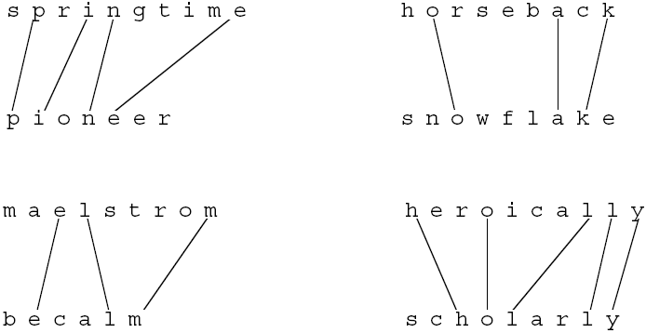
Longest Common Subsequence

Slide 27
Brute Force Approach
For every subsequence of X, check whether it’s a subsequence of Y .
  Time: Θ(n2^{m}).
2^{m} subsequences of X to check.
Each subsequence takes Θ(n) time to check: scan Y for first letter, from there scan for second, and so on.

Slide 28
Optimal Substructure
Let Z = z₁, . . . , z_{k} be any LCS of X and Y
If x_{m} = y_{n}, then z_{k} = x_{m} = y_{n} and Z_{k−1} is an LCS of X_{m−1} and Y_{n−1}.
If x_{m} ≠ y_{n}, then z_{k} ≠ x_{m} ⇒ Z is an LCS of X_{m−1} and Y .
If x_{m} ≠ y_{n}, then z_{k} ≠ y_{n} ⇒ Z is an LCS of X and Y_{n−1}.

Slide 29
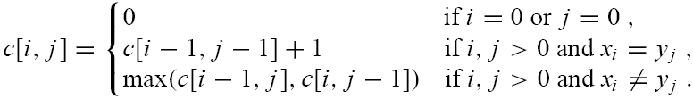
Recursive Formulation
If x_{i} = y_{j}, then find LCS for X_{i−1} and Y_{j−1}
If x_{i} ≠ y_{j}, then we have 2 subproblems:
  Find LCS for X_{i−1} and Y
  Find LCS for X and Y_{j−1}
Define c[i, j ] = length of LCS of X_{i} and Y_{j} . We want c[m, n].

Slide 30
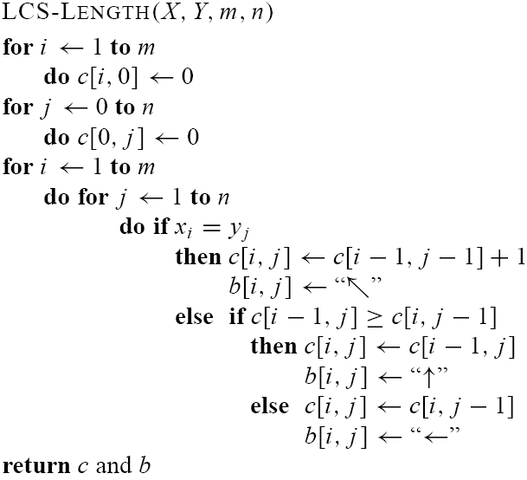
Compute Length of Optimal LCS

Slide 31
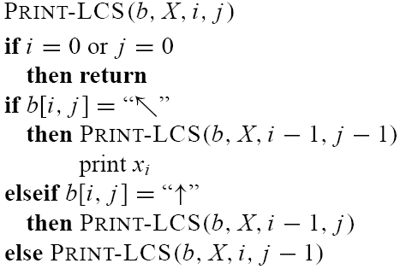
Constructing the LCS

Slide 32
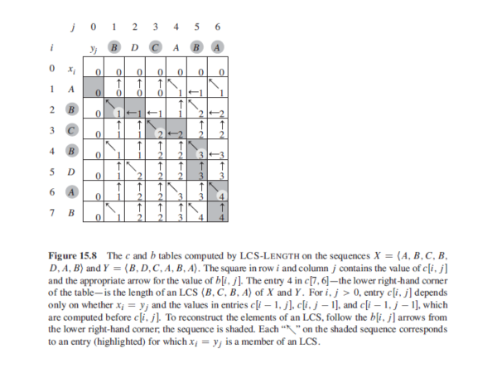

Slide 33
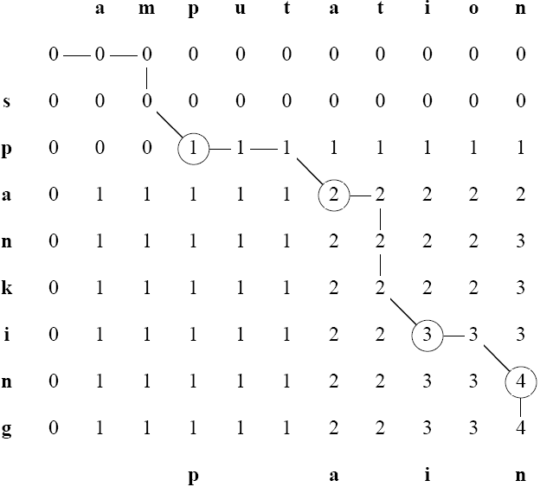
Example

